Slide 1



Analytical Data Fusion Approaches to Update Mobility Patterns in Real-time
Prateek Bansal
Presidential Young (Assistant) Professor
National University of Singapore

Slide 2




Team
Khoa Vo Dang
Eui-Jin Kim
Prateek Bansal
Huichang Lee
Notes:
Should not the duration be 1 and 1, instead of 8 and 11, in Z_bar?
How can arrival an departure time be same in T?

Slide 3
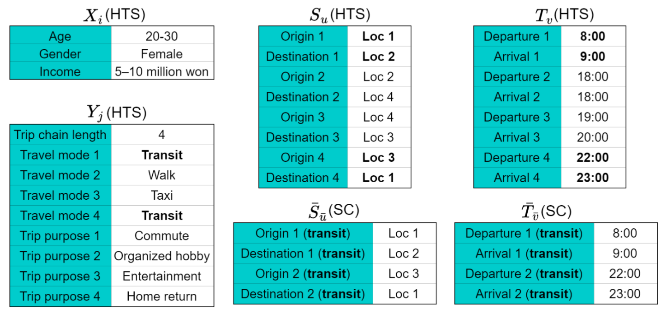
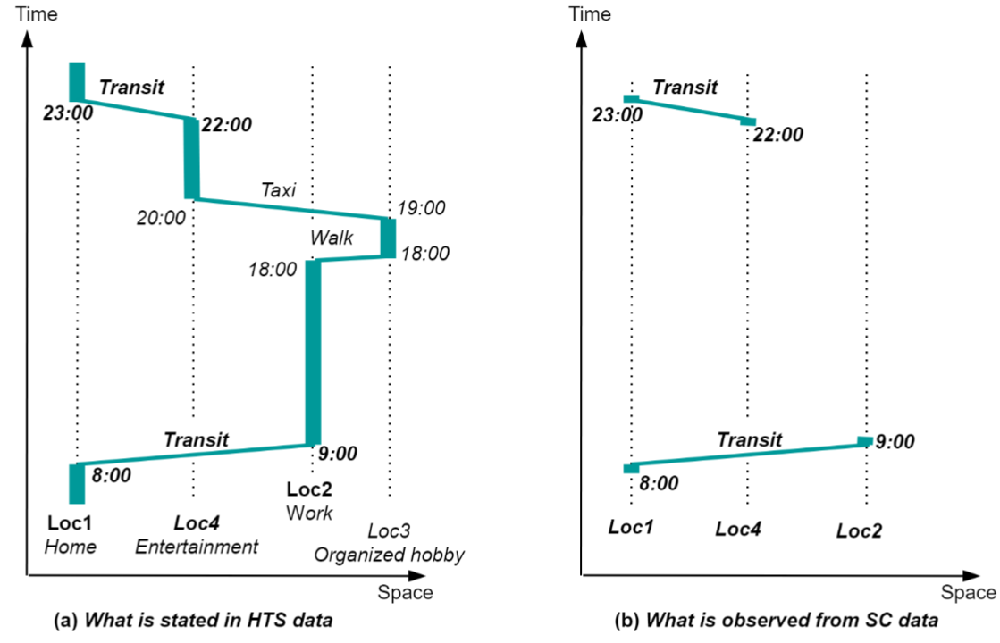





Research Problem: Activity Generation
$$S$$
$$X$$
$$Y$$
$$T$$
Billions of attribute value combinations
Notes:
Should not the duration be 1 and 1, instead of 8 and 11, in Z_bar?
How can arrival an departure time be same in T?

Slide 4
Low Spatiotemporal Heterogeneity in Household Travel Survey (HTS)
b
Sample (N=20)
Population (N=5400)
a
Depart ≤ 9:00
Depart ≤ 9:00
3 zones
 | a | b | c | Σ
a | 2 | 2 | 1 | 5
b | 1 | 1 | 1 | 3
c | 2 | 0 | 0 | 2
Σ | 5 | 3 | 2 | 10
 | a | b | c | Σ
a | 300 | 300 | 400 | 1000
b | 300 | 300 | 400 | 1000
c | 400 | 200 | 200 | 800
Σ | 1000 | 800 | 1000 | 2800
c
HTS (Total = 20, ~0.4%)
 | a | b | c | Σ
a | 3 | 2 | 2 | 7
b | 3 | 4 | 2 | 9
c | 2 | 2 | 0 | 4
Σ | 8 | 8 | 4 | 20
“Zero cell” problem
Only transit H-W trips
Depart > 9:00
Depart > 9:00
 | a | b | c | Σ
a | 1 | 0 | 1 | 2
b | 2 | 3 | 1 | 6
c | 0 | 2 | 0 | 2
Σ | 3 | 5 | 2 | 10
 | a | b | c | Σ
a | 300 | 300 | 200 | 800
b | 300 | 300 | 200 | 800
c | 400 | 400 | 200 | 1000
Σ | 1000 | 1000 | 600 | 2600
Notes:
Use sc data to improve for transit travelers.

Slide 5
Low Spatiotemporal Heterogeneity in HTS Data
b
Depart ≤ 9:00
Male
Depart ≤ 9:00
Female
a
Depart ≤ 9:00
3 zones
 | a | b | c | Σ
a | 2 | 2 | 1 | 5
b | 1 | 1 | 1 | 3
c | 2 | 0 | 0 | 2
Σ | 5 | 3 | 2 | 10
 | a | b | c | Σ
a | 2 | 0 | 1 | 3
b | 0 | 1 | 0 | 1
c | 1 | 0 | 0 | 1
Σ | 3 | 1 | 1 | 5
 | a | b | c | Σ
a | 0 | 2 | 0 | 2
b | 1 | 0 | 1 | 2
c | 1 | 0 | 0 | 1
Σ | 2 | 2 | 1 | 5
c
HTS (Total = 20)
 | a | b | c | Σ
a | 3 | 2 | 2 | 7
b | 3 | 4 | 2 | 9
c | 2 | 2 | 0 | 4
Σ | 8 | 8 | 4 | 20
“Zero cell” problem
Depart > 9:00
Male
Depart > 9:00
Female
Depart > 9:00
 | a | b | c | Σ
a | 1 | 0 | 1 | 2
b | 2 | 3 | 1 | 6
c | 0 | 2 | 0 | 2
Σ | 3 | 5 | 2 | 10
 | a | b | c | Σ
a | 1 | 0 | 0 | 1
b | 0 | 2 | 1 | 3
c | 0 | 1 | 0 | 1
Σ | 1 | 3 | 1 | 5
 | a | b | c | Σ
a | 0 | 0 | 1 | 1
b | 2 | 1 | 0 | 3
c | 0 | 1 | 0 | 1
Σ | 2 | 2 | 1 | 5
Notes:
Use sc data to improve for transit travelers.

Slide 6
Can Econometrics Methods Handle Zero Cell Issue in HTS?
Location and departure time choice problem
Pros: Partially address zero-cell problem
Cons: large choice set for destination choice + lack of consistency due to curse-of-dimensionality
Notes:
Use sc data to improve for transit travelers.

Slide 7
Research Gap
Limitation of HTS dataset
Low spatiotemporal heterogeneity due to low sampling rate (~1%)
Low frequency of data collection
Limitation of Econometric Methods
No reliable econometric models to generate sequence of destination choice conditional on demographics.
Existing econometric models predict each activity’s choice dimensions (e.g., duration, purpose, and mode) independently, leading to inconsistency across different choice dimensions.

Slide 8
Potential Directions: Passively Collected Data (PCM)
Examples: Smart Card (SC) and Time-dependent Origin-Destination Matrices
Advantages
The mobility digital twin can be updated everyday.
Equity analysis can be conducted.
Activity patterns can serve as initial heterogeneous plans for activity-based models.
Data sources | Socio-demographic | Activity purpose | Travel mode | Spatial attribute | Temporal attribute
HTS | High | High | High | Low | Low
PCM | Unavailable | Unavailable | Unavailable | High | High

Slide 9
Analytical Data Fusion of HTS with PCM Data
Part 1: Fuse HTS with Smart Card (SC) Data
Mainly useful in cities with high transit share (e.g., Singapore, Seoul, Beijing, and London).
Part 2: Fuse HTS with Time-Dependent Origin-Destination (TD-OD) Matrices
More widely applicable globally and more privacy preserving approach

Slide 10
Part 1: Fuse HTS + SC Data

Slide 11
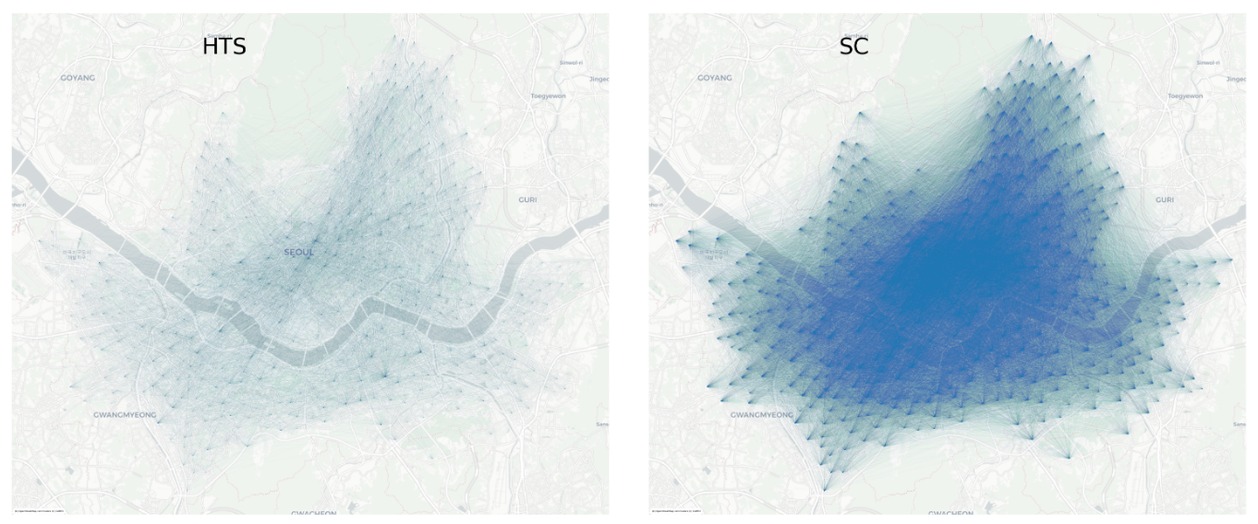
Potential of Smart Card (SC) Data
Spatial distributions of OD pairs in HTS and SC data (Seoul, Korea 2016)
HTS data has ~30 thousand transit riders, and that of the SC data is ~1 million.
OD pair: ~31 thousand in the HTS data and ~120 thousand in the SC data

Slide 12
Key Research Question
How to simultaneously synthesize sociodemographics and joint distribution of activity schedules and increase heterogeneity in activity schedules of transit users while reserve the distribution of key variables observed in HTS and SC data?

Slide 13
Methodology
Activity schedule vs. observation
Note: Times and spaces in SC data are aggerated at a zone and an hourly levels so that they are consistent with those of HTS data
Notes:
Should we say 8:10 and 8:50 and 20:10 and 20:50? You can do this for SC. The time resolution in HTS data is hourly.

Slide 14

Methodology
Attribute definition
Spatiotemporal attributes for incomplete trip chains
Notes:
Should not the duration be 1 and 1, instead of 8 and 11, in Z_bar?
How can arrival an departure time be same in T?

Slide 15
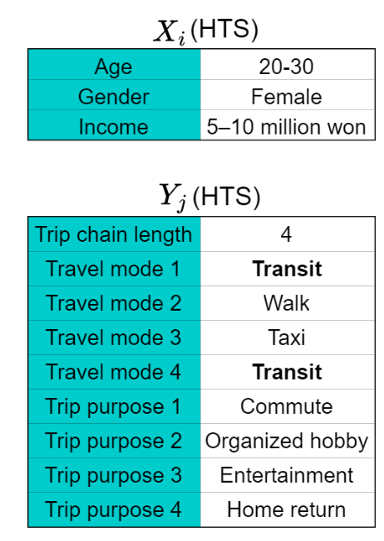
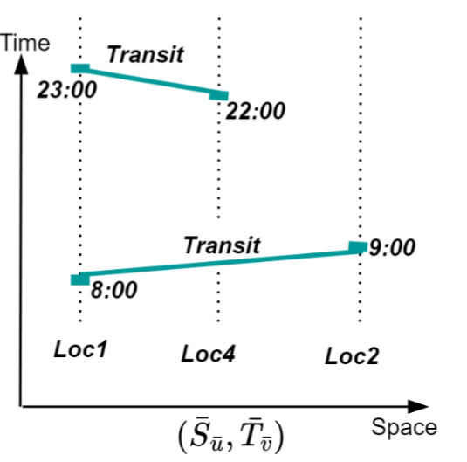
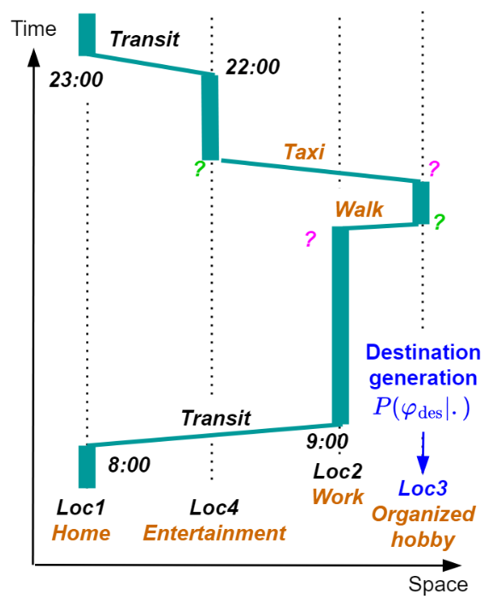
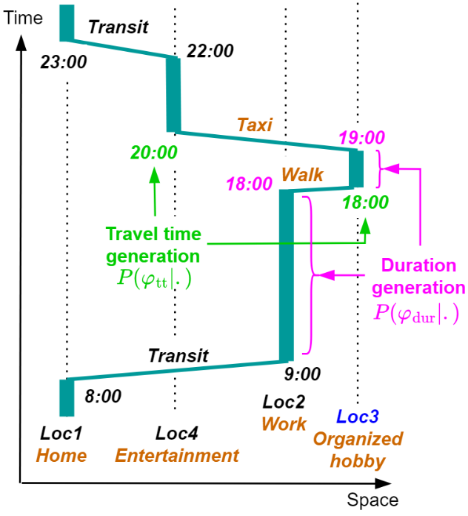
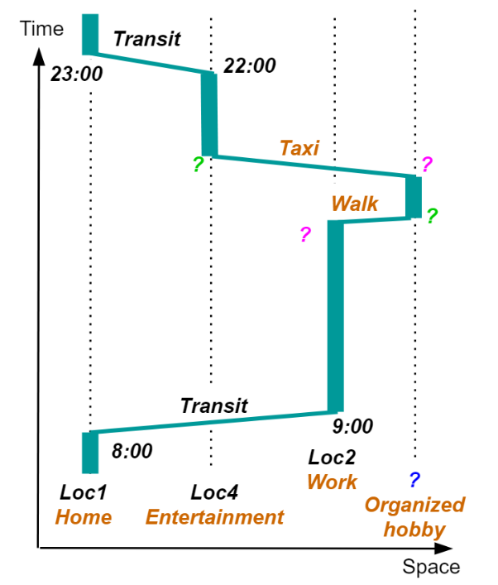
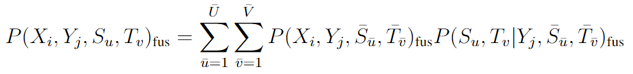
Methodology
Step 2: Generating space and time of non-transit trips
Spatial
Temporal
Step 1: Data fusion

Slide 16
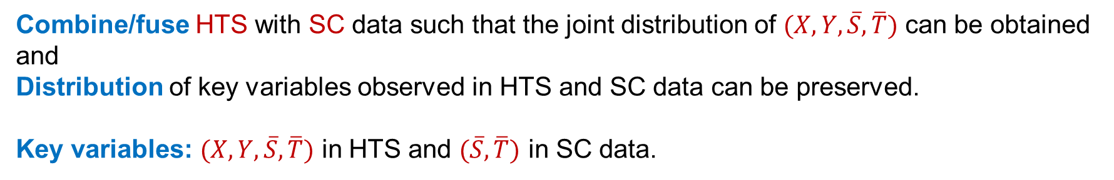
Problem Statement: Data Fusion
Combine/fuse HTS with SC data such that the joint distribution of $(X,Y,\overline{S},\overline{T})$ can be obtained
and
Distribution of key variables observed in HTS and SC data can be preserved.
Key variables: $(X,Y,\overline{S},\overline{T})$ in HTS and $(\overline{S},\overline{T})$ in SC data.

Slide 17
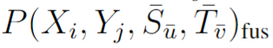
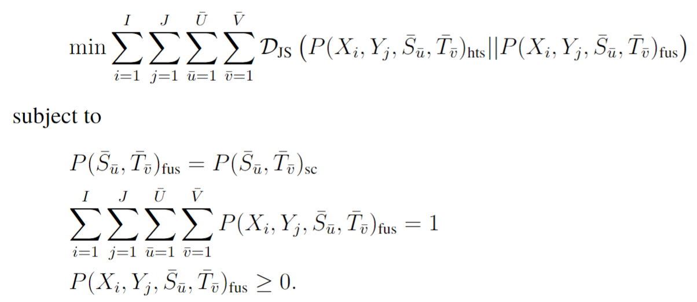
Methodology
Data fusion problem formulation
Finding

Slide 18
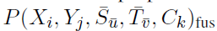
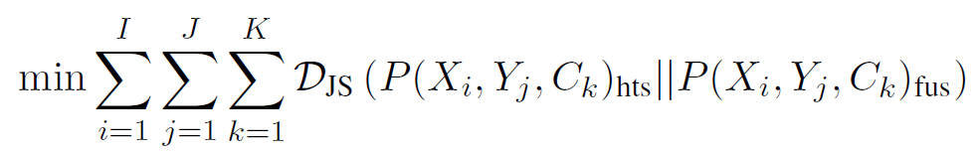
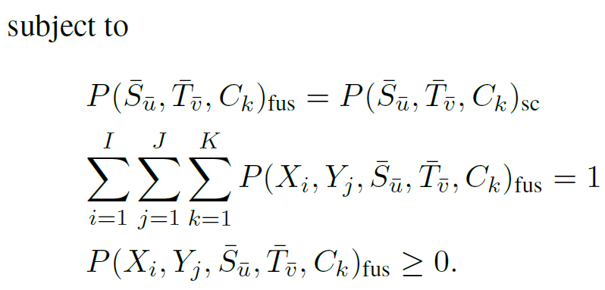
Methodology
Approximated data fusion problem
Finding
Approximation with spatiotemporal clustering

Slide 19
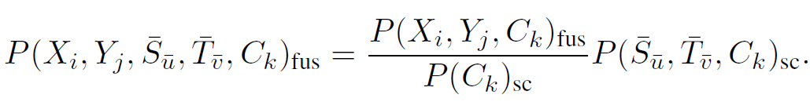
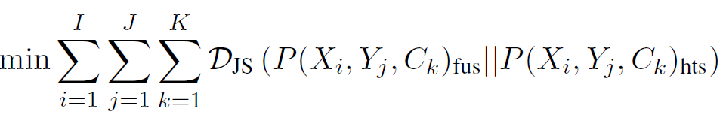
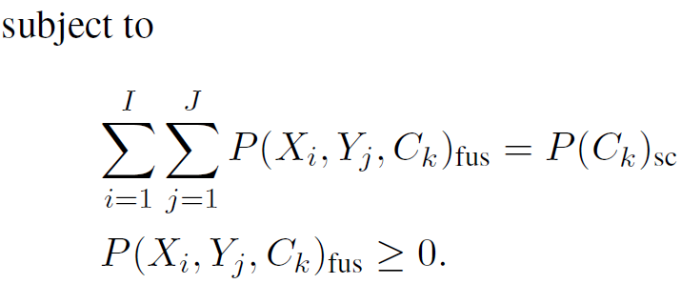
Methodology
Solution to the approximated data fusion problem Conditional on Clustering
Problem P1
Notes:
Why is it important to “separate S_bar and T_bar”? I see the reason while reading the document. Here, the reasoning of independence of T_bar with X_i and y_j is more important for the first equation.

Slide 20
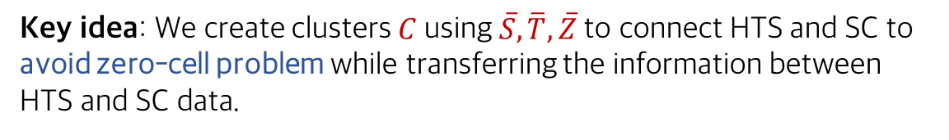
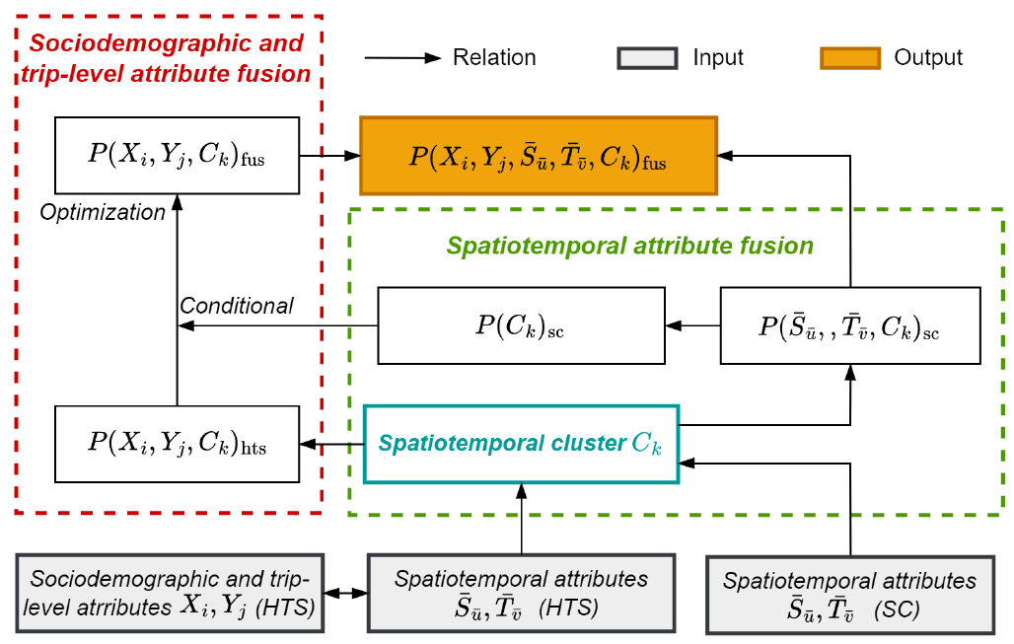
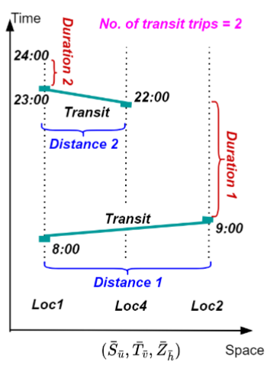
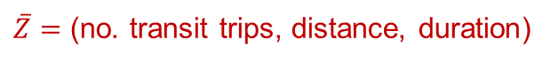
Methodology
Data fusion method
Clustering C
$\overline{Z}=$ (no. transit trips, distance, duration)
Notes:
1. How do we go from S_bar to S and T_bar to T?
2. Where is Y coming into picture specifically?
3. What S and S_bar specifically? Joint distribution of a sequence of locations? And same for T_bar
4. Similarly, y is a joint distribution of purpose and travel mode for a trip or for a sequence of trips? Should not we first generate the number of trips? How do we ensure that if there are three trips, exactly three locations are generated? Is that the reason why we have Z_bar in generating spatial and temporal attributes? However, is not Z_bar just have number of transit trips in a day not all trips. The process of generating trip chain is bit unclear.
5. Why do we call red boxes spatial and temporal imputation when we are just taking linear combinations?
6. Why is there no connection between spatial and temporal imputation, specially important because we do S_bar,Z_bar,C_k for spatial but for temporal we do S_bar, T_bar, and Z_bar (i.e., spatial component is involved while evaluating temporal spatial combination).

Slide 21
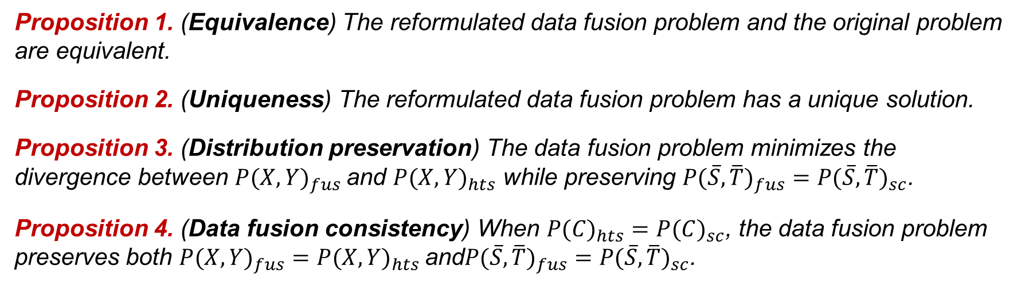
Properties of the Data Fusion Problem
Proposition 1. (Equivalence) The reformulated data fusion problem and the original problem are equivalent.
Proposition 2. (Uniqueness) The reformulated data fusion problem has a unique solution.
Proposition 3. (Distribution preservation) The data fusion problem minimizes the divergence between $P(X,Y)_{fus}$and $P(X,Y)_{hts}$ while preserving $P(\overline{S},{\overline{T})}_{fus}=P(\overline{S},{\overline{T})}_{sc}$.
Proposition 4. (Data fusion consistency) When $P(C)_{hts}=P(C)_{sc}$, the data fusion problem preserves both $P(X,Y)_{fus}=P(X,Y)_{hts}$and$P(\overline{S},{\overline{T})}_{fus}=P(\overline{S},{\overline{T})}_{sc}$.
Use it for clustering

Slide 22
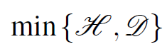
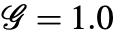
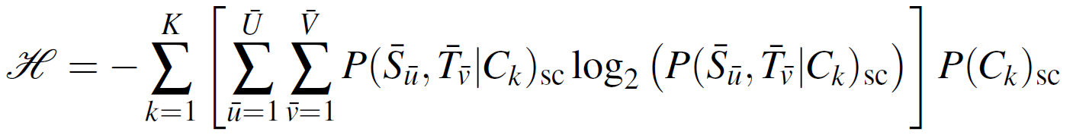
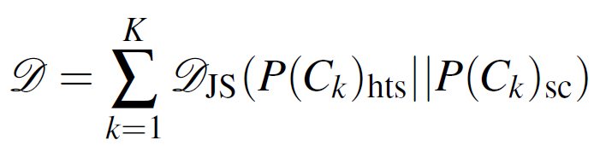
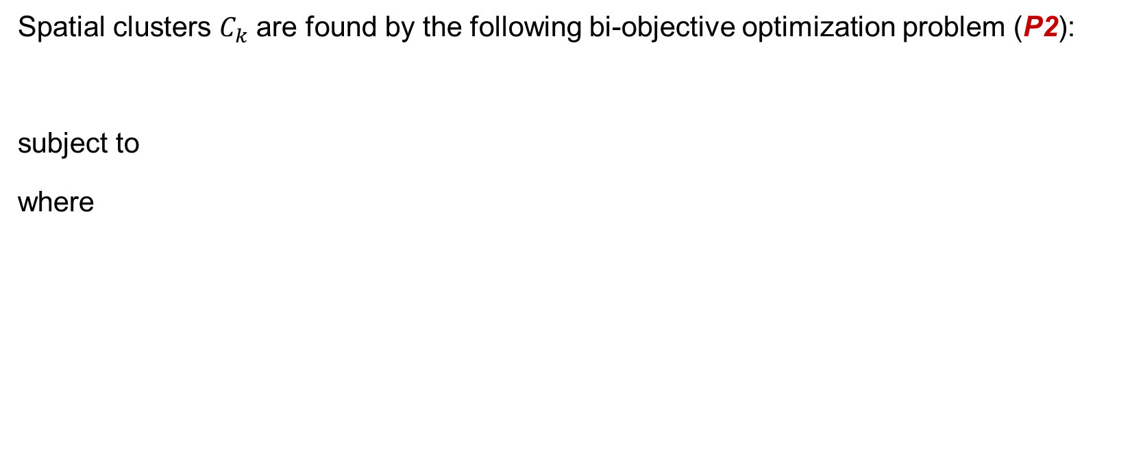
Cluster Optimization
Spatial clusters $C_{k}$ are found by the following bi-objective optimization problem (P2):
subject to
where
Balance of feasibility and heterogeneity (or data fusion consistency and clustering information gain)
Prop. cluster with at least one observation in HTS and SC data (i.e., no zero cells)
Clustering information gain (or inverse entropy)
Divergence for data fusion consistency in the common attribute distribution

Slide 23
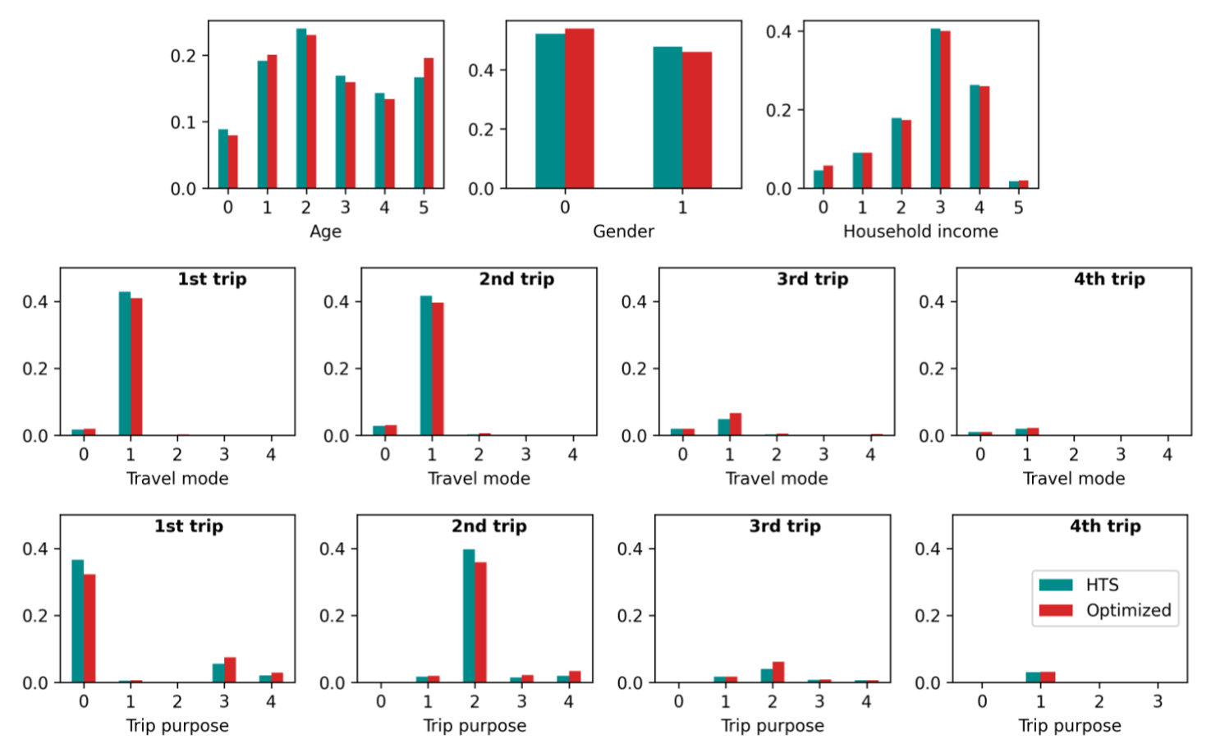
Case study
Marginal distributions
Well fit
Slightly under-reporting of non-transit trips in HTS data
Slightly under-reporting of non-commute trips in HTS data
Travel mode: 0-walk, 1-transit, 2-auto, 3-bike, 4-taxi
Trip purpose: 0-commute, 1-work, 2-home return, 3-organized hobby, 4-entertainment
23
Notes:
How did we decide K?
I think last column of the second table should be excluded.
What is divergence?

Slide 24
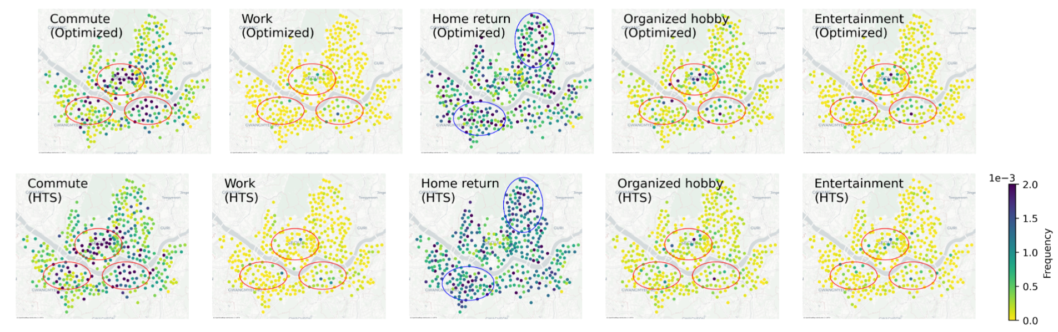
Case study
Red circles: 3 major business districts
Blue circles: 2 major residential areas
Destination choices
→ More leisure activities across the space, especially at business districts where these leisure activities could be conducted before or after work.
→ More work activities (i.e., go to workplace not from home) at business districts.
24
Notes:
How did we decide K?
I think last column of the second table should be excluded.
What is divergence?

Slide 25
Take aways
A nonparametric method that can deal with high dimensionality of spatial attributes caused by large location combinations in both HTS and SC data.
The method can well infer a large number of new activity schedules while maintaining the attribute distributions (both joint and marginal) in HTS and SC data.
The method can explore new spatial patterns for leisure activities unable to be observed from a conventional HTS due to its low sampling rate.
The method can also handle incomplete SC trip chains.

Slide 26


Ongoing and Future Work
Two approaches to generate synthetic population with entire activity chains of transit riders.
Analytical approach
GenAI Approach

Slide 27
Part 2: Fuse HTS + TD-OD Data

Slide 28
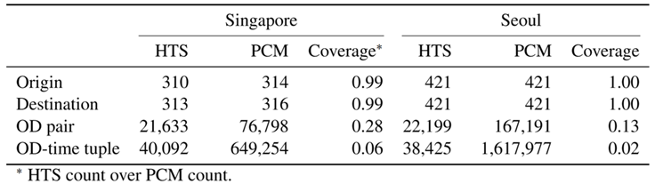
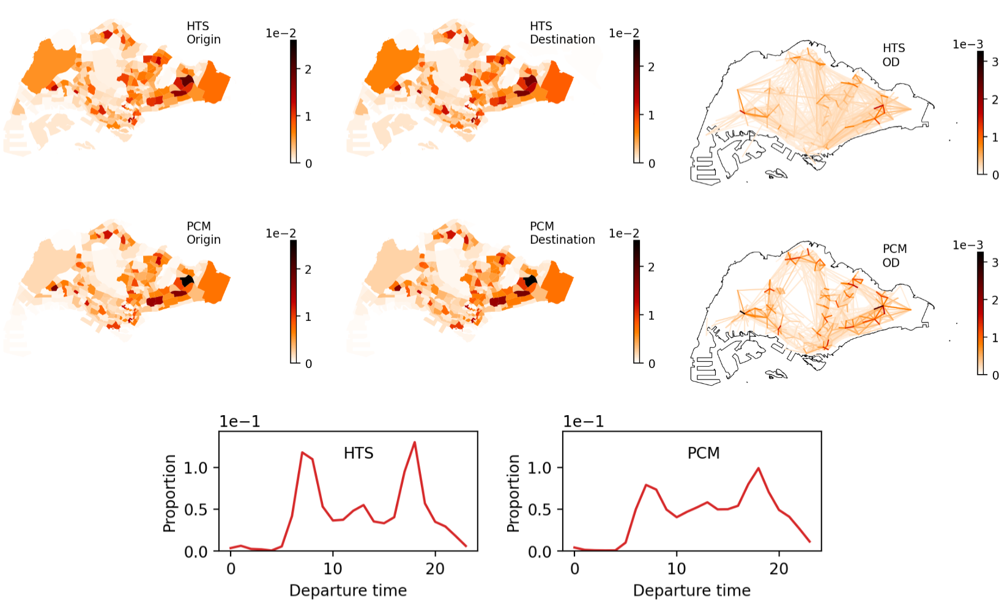
Potential of TD-OD matrix: Motivation
HTS and PCM data for Singapore:
Marginals are consistent
HTS has low spatial and temporal heterogeneity

Slide 29
Potential of TD-OD matrix: Motivation
Time-Dependent Origin-Destination (TD-OD) matrices
Summarize mobility as trip volumes between locations over time.
Easily obtained from PCM data.
Preserves privacy as it is an aggregated form of mobility data.
Covers higher proportion of the population.
Limitations:
Lack of trip interdependencies.
Absence of sociodemographic and trip-chain attribute details.
Balancing data utility and privacy is key for future mobility research.
Solution: Enhancing TD-OD Matrix with HTS data

Slide 30
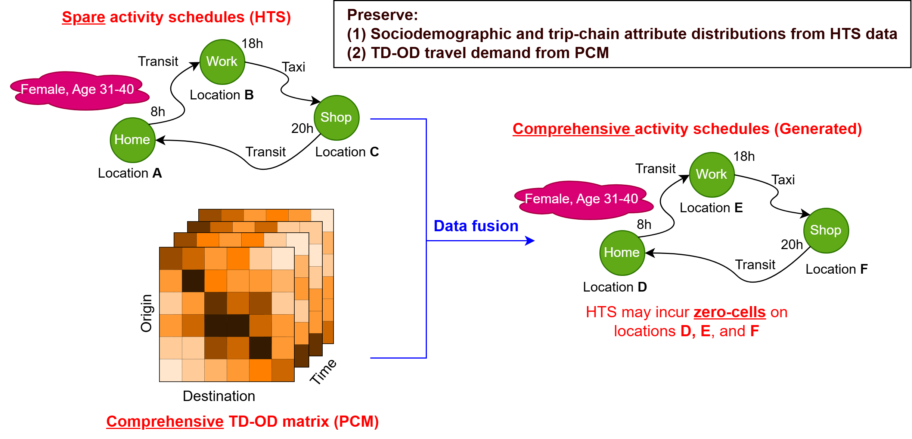
Problem Statement

Slide 31
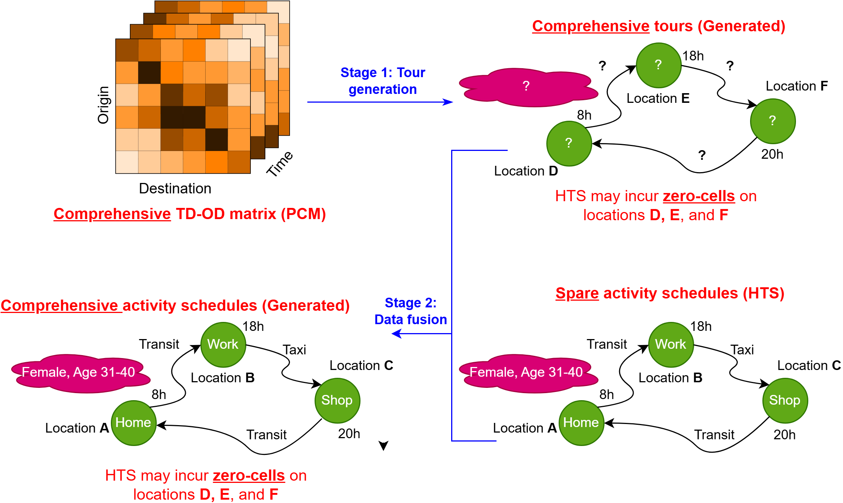
Conventional Approach

Slide 32
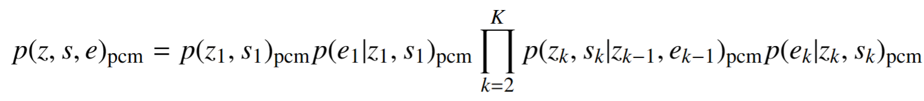
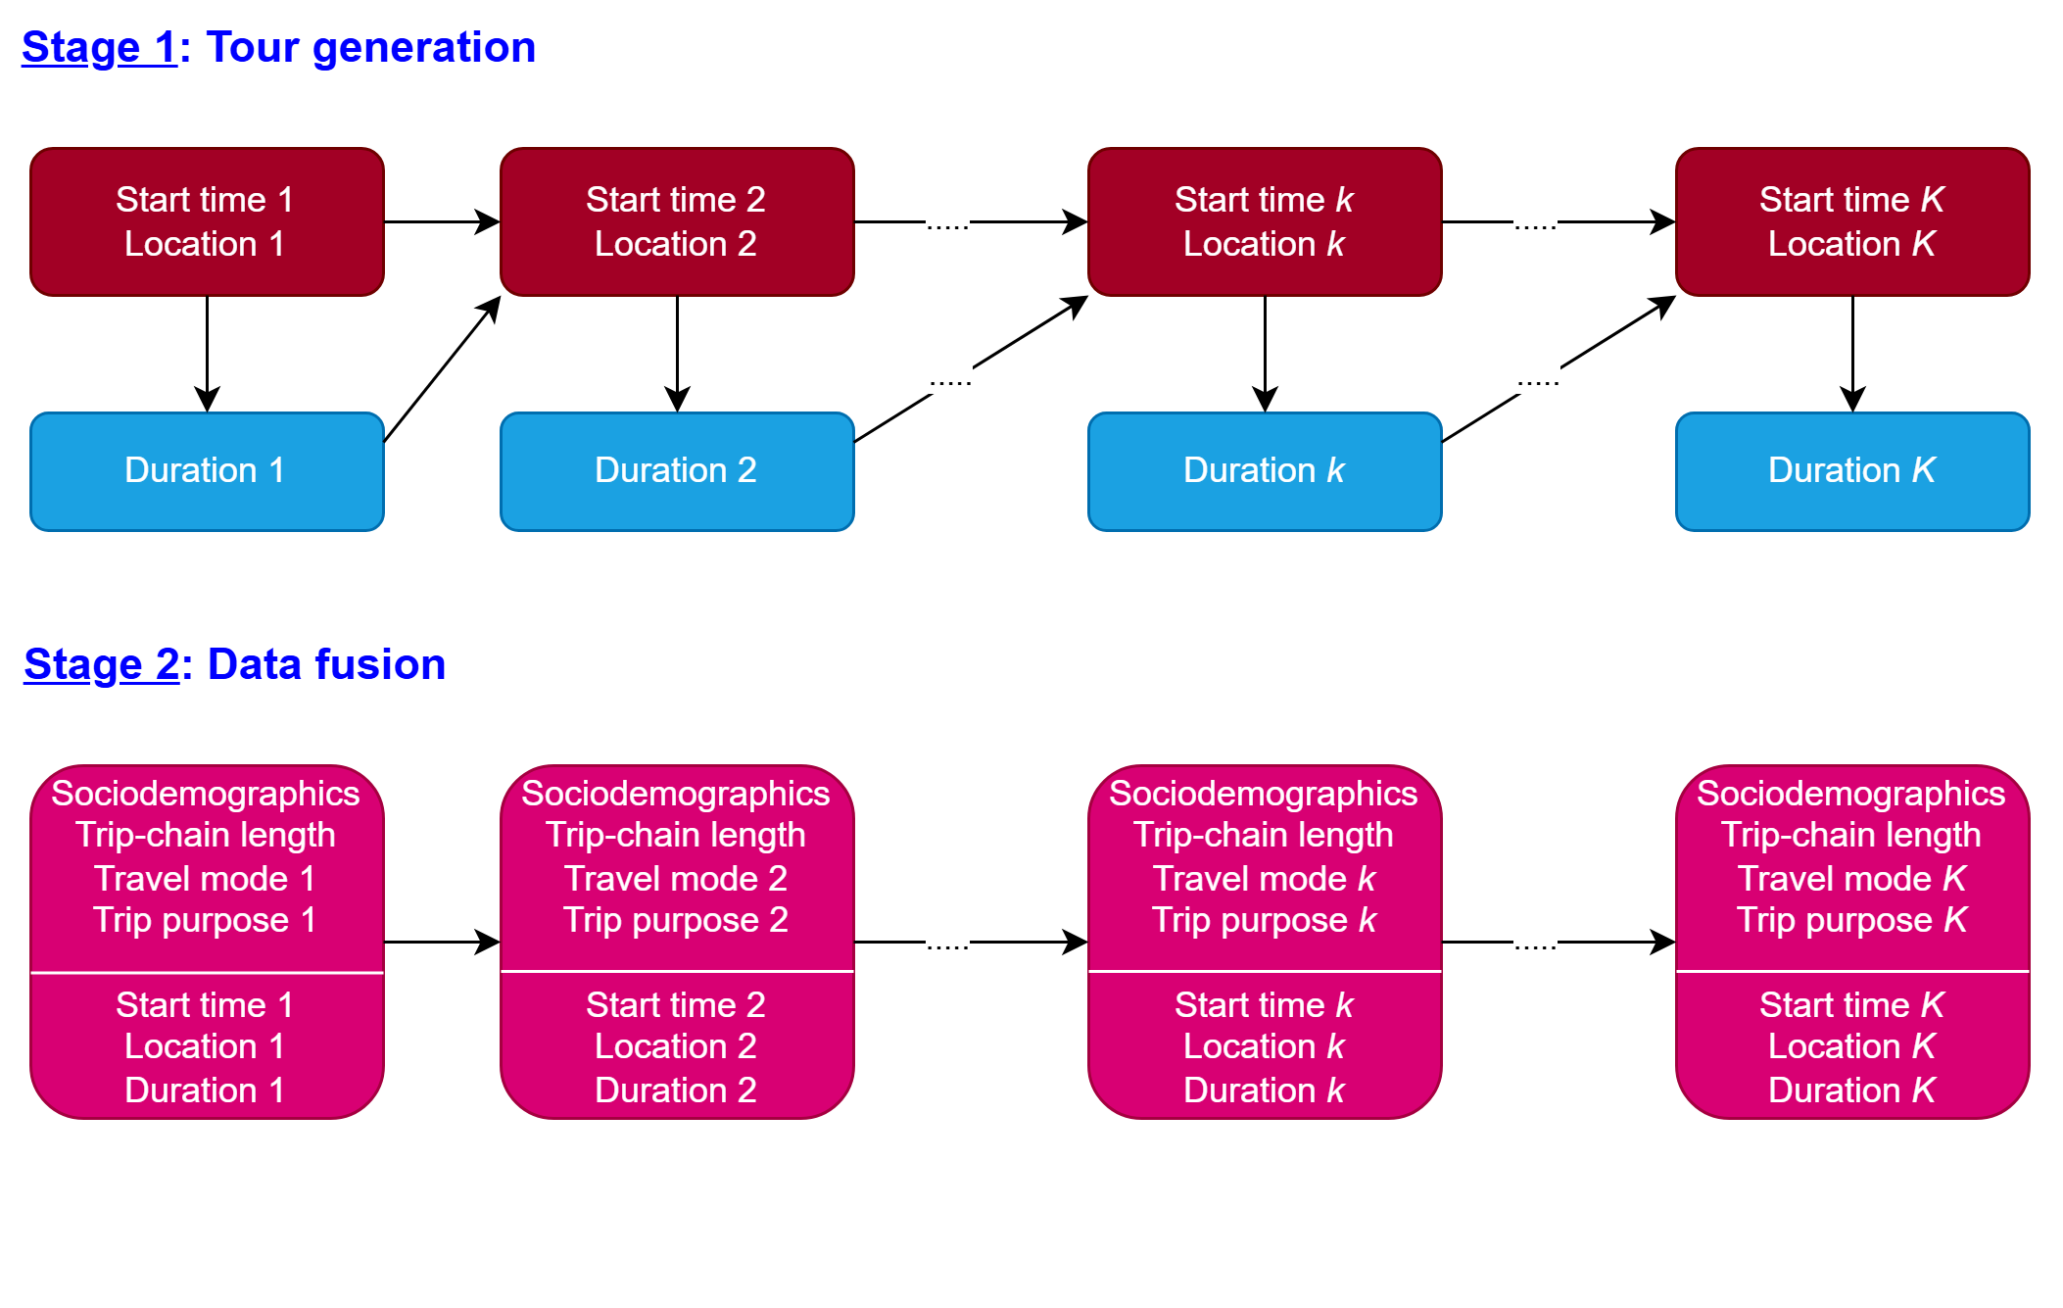
Conventional Approach: Stage 1
z: activity location
s: start time
e: end time
k: activity order
Stage 1: Tour generation [1,2]
[1] Anda, C., Medina, S.A.O., Axhausen, K.W., 2021. Synthesizing digital twin travelers: Individual travel demand from aggregated mobile phone data. Transportation Research Part C 128, 103118.
[2] Ballis, H., Dimitriou, L., 2020. Revealing personal activities schedules from synthesizing multi-period origin-destination matrices. Transportation research part B139, 224–258.

Slide 33
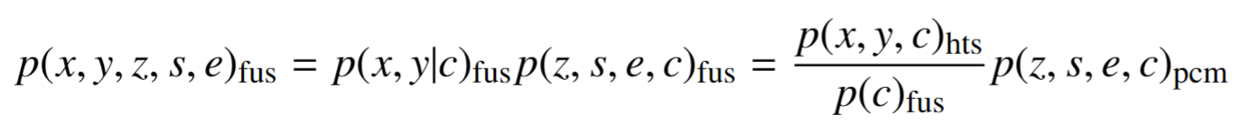
x: socio- demographics (e.g., age, gender)
y: trip-chain attributes (i.e., trip purpose,
mode choice, trip-chain length)
z: activity location
s: start time
e: end time
c: extracted features
Conventional Approach: Stage 2
Stage 2: Data fusion (or imputation) [3]
[3] Ye, J., Hu, Y., Gao, L., 2024. Data-driven framework for generating travelers with demographic-activity-travel information. Transportation Research Record 2678, 1–13.

Slide 34
Key Issues
Feasibility: The tour generation in Stage 1 often produce a significant number of infeasible attribute value combinations (i.e., activity locations and times).
Distribution preservation: The data fusion in Stage 2 cannot maintain the distribution preservation in the fused output (i.e., joint distribution of all attributes from HTS data and spatiotemporal distribution of TD-OD travel demand from PCM data).
Spatiotemporal granularity: The data fusion in Stage 2 relies on assumptions about the granularity of the feature space to bridge the PCM data with the HTS data (i.e., the finer-gained causes more zero-cells in HTS data while the coarser-gained causes more infeasibility).

Slide 35
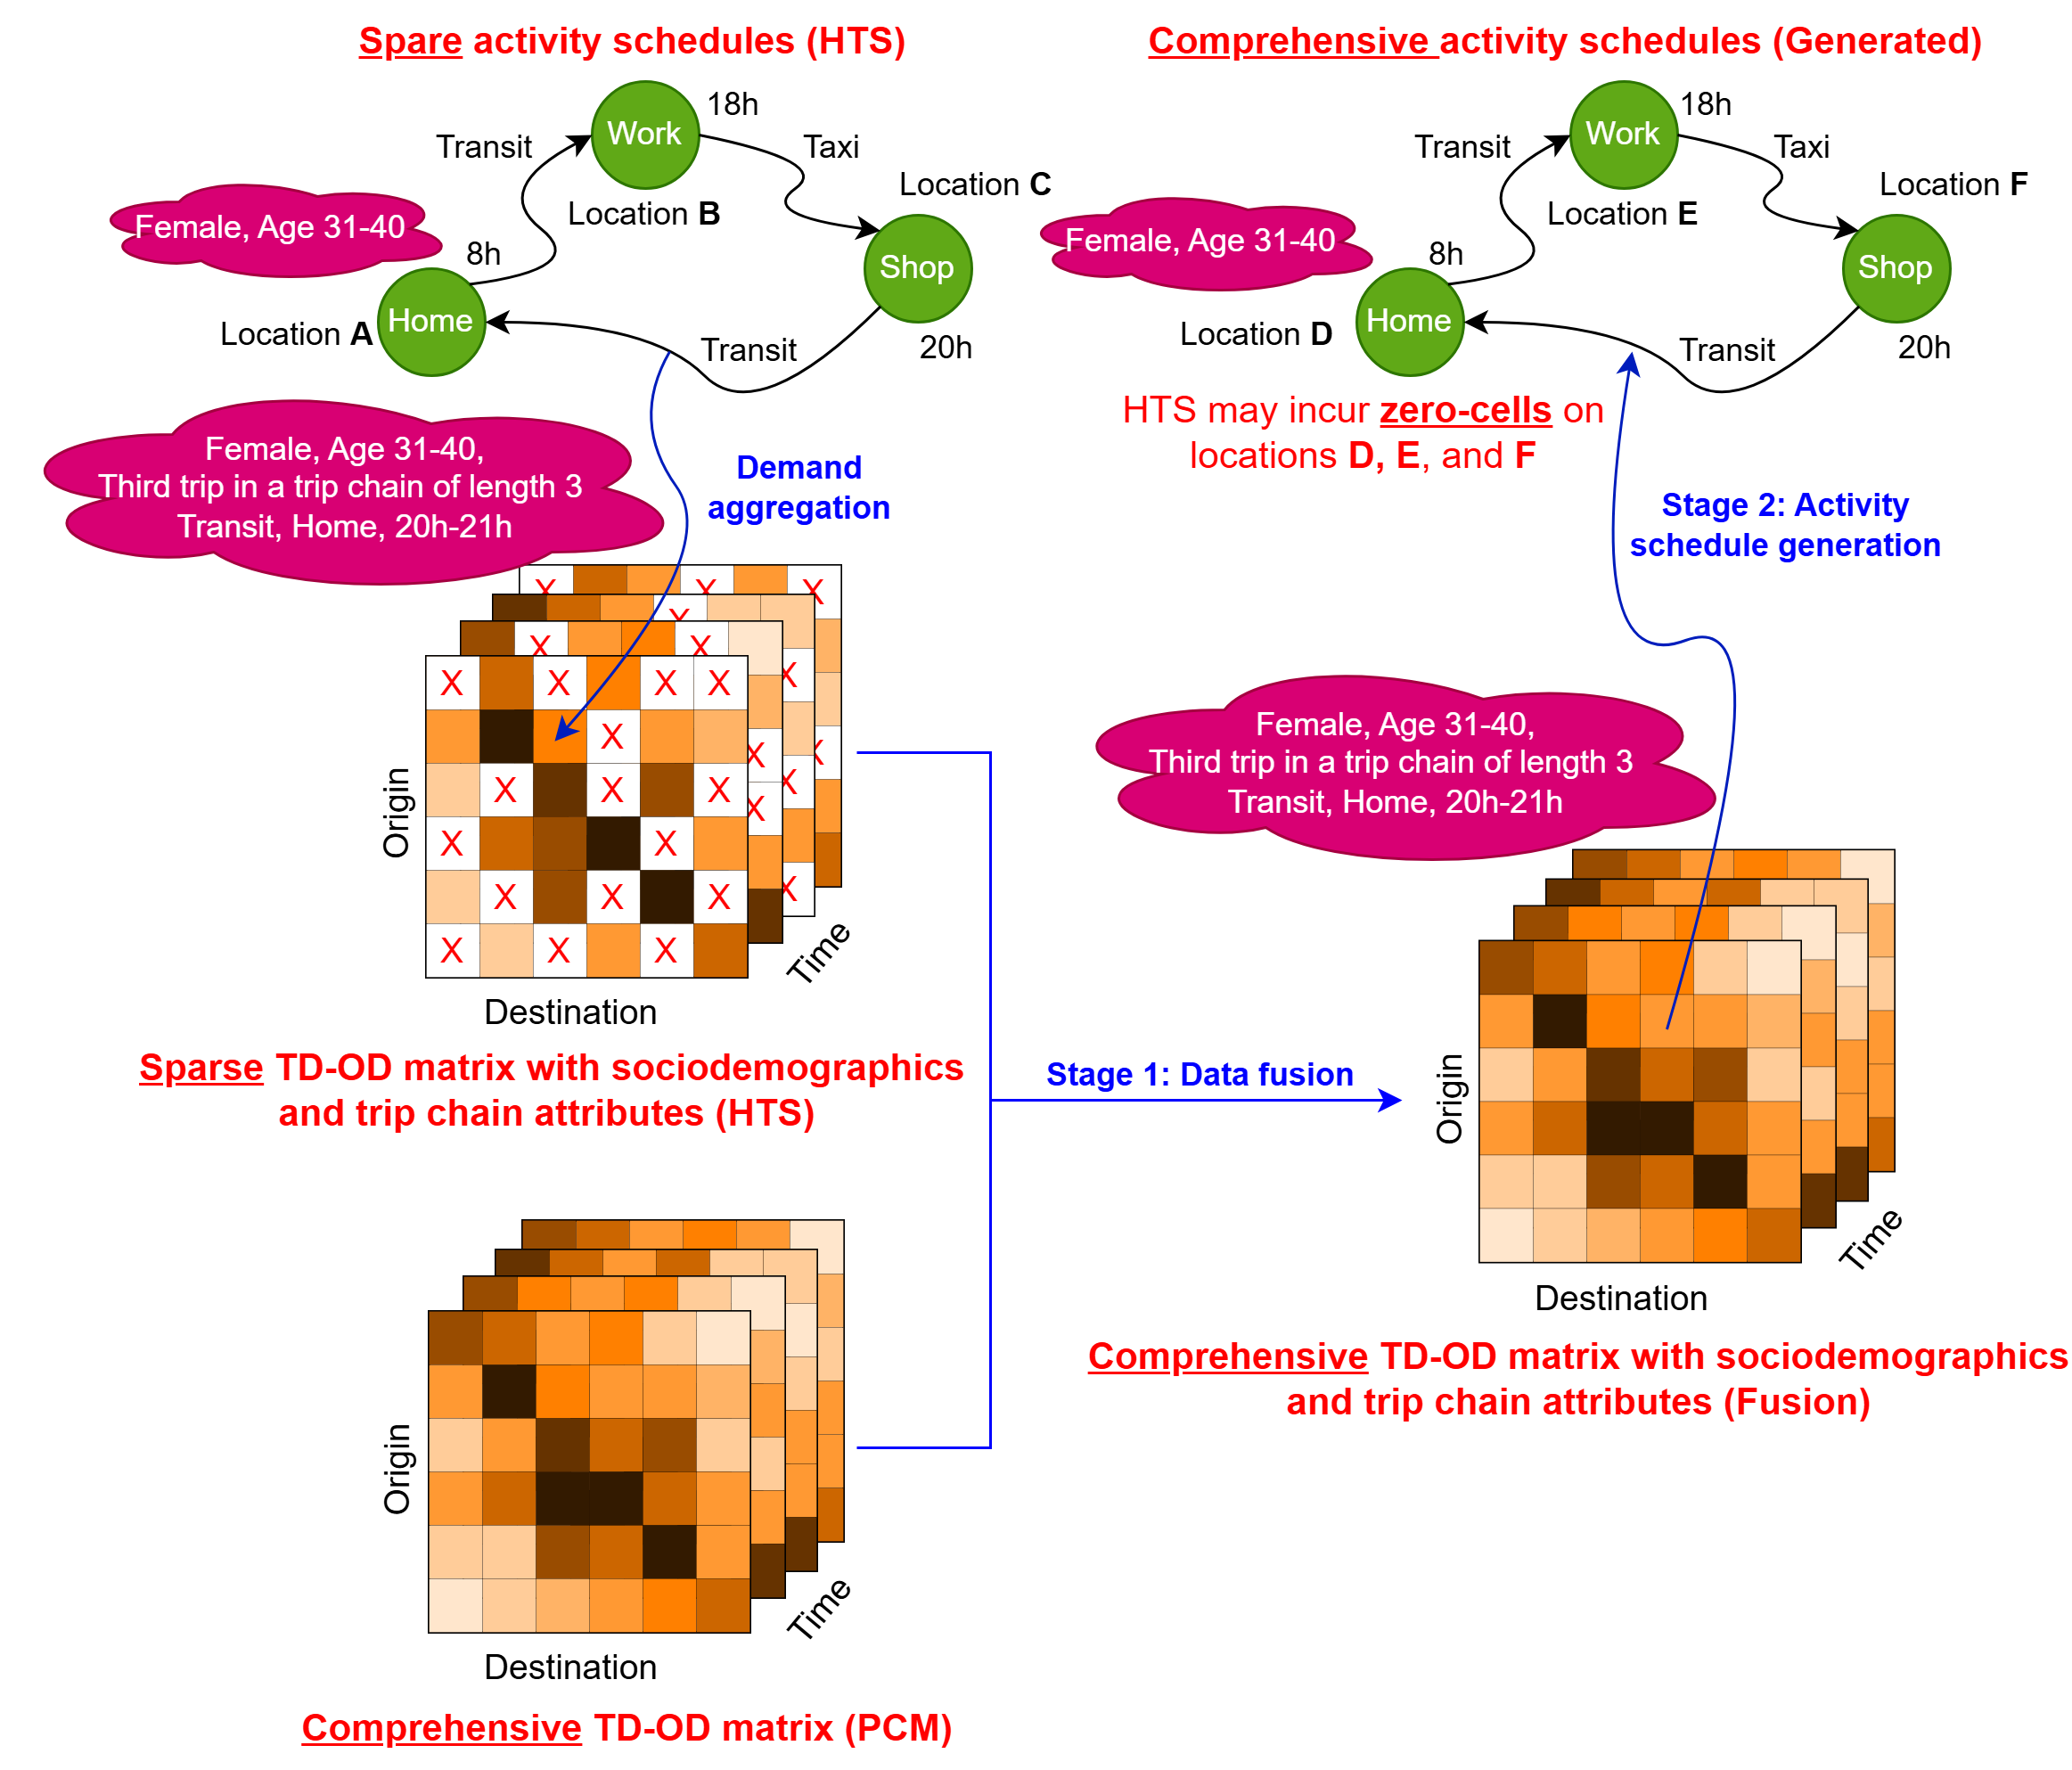
Proposed Approach
Conventional:
First tour generation, then data fusion
Proposed:
First data fusion, then activity schedule generation

Slide 36
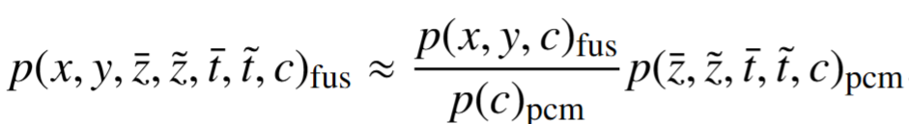
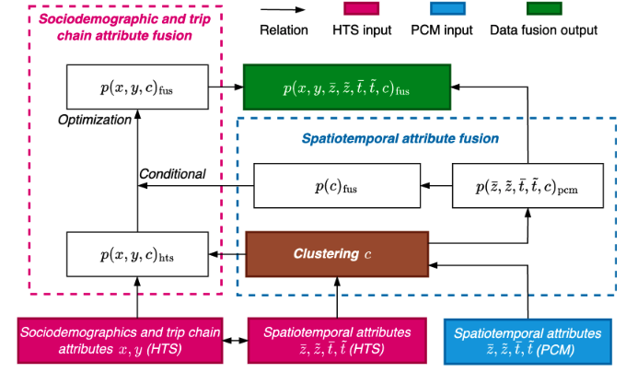
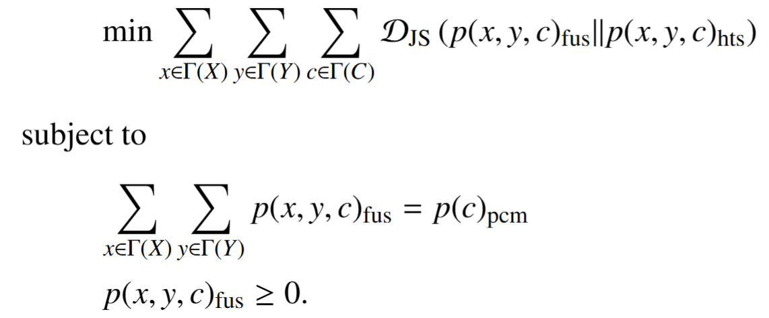
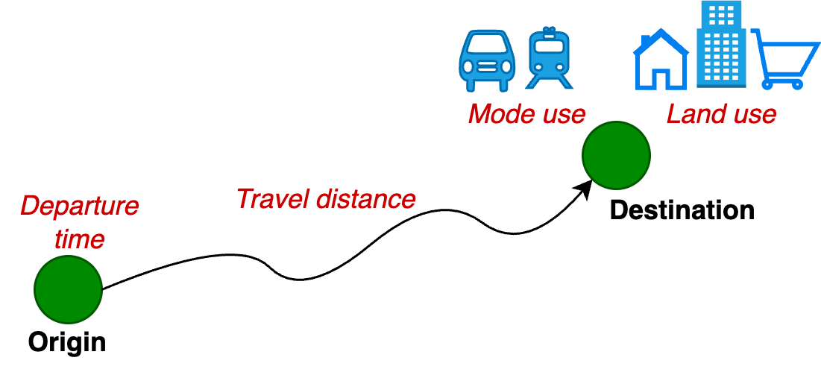
Proposed Approach: Stage 1 (Data Fusion)
TD-OD matrix
Feature extraction for clustering
[4] Vo, K.D., Kim, E.J., Bansal, P., 2025. A novel data fusion method to leverage passively-collected mobility data in generating spatially-heterogeneous synthetic population. Transportation Research Part B 191.

Slide 37
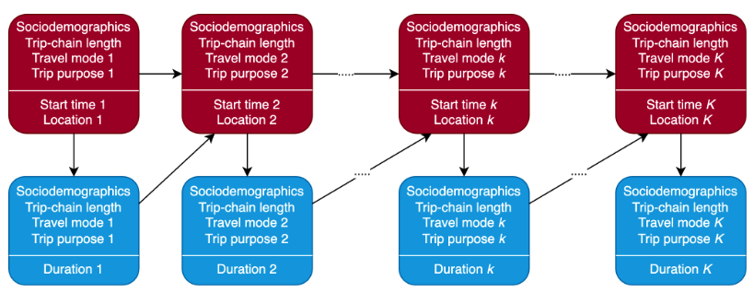
Proposed Approach: Stage 2 (Activity Schedule Generation)
Additional information on sociodemographics and trip-chain attributes

Slide 38
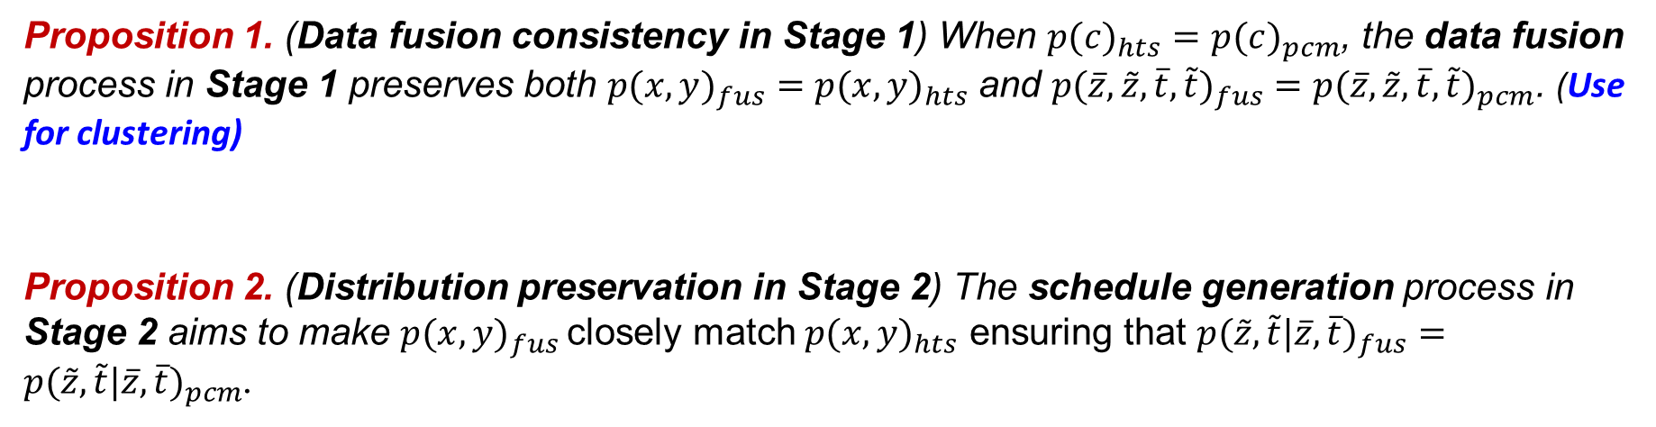
Proposed Approach: Properties
Proposition 1. (Data fusion consistency in Stage 1) When $p(c)_{hts}=p(c)_{pcm}$, the data fusion process in Stage 1 preserves both $p(x,y)_{fus}=p(x,y)_{hts}$ and $p({\overline{z},\tilde{z},\overline{t},\tilde{t})}_{fus}=p(\overline{z},\tilde{z},{\overline{t},\tilde{t})}_{pcm}$. (Use for clustering)
Proposition 2. (Distribution preservation in Stage 2) The schedule generation process in Stage 2 aims to make $p(x,y)_{fus}$closely match $p(x,y)_{hts}$ ensuring that $p(\tilde{z},\tilde{t}|{\overline{z}, \overline{t})}_{fus}=p(\tilde{z},\tilde{t}|\overline{z}, {\overline{t})}_{pcm}$.
[4] Vo, K.D., Kim, E.J., Bansal, P., 2025. A novel data fusion method to leverage passively-collected mobility data in generating spatially-heterogeneous synthetic population. Transportation Research Part B 191.
Access the full paper to see the details

Slide 39
Proposed Approach: Benefits
Feasibility: The activity schedule generation in Stage 2 is be improved due to incorporation of socio-demographics and trip-chain attributes (i.e., trip-chain length and order) when determining the next activity location, start time and duration.
Distribution preservation: The data fusion in Stage 1 minimizes distance from joint distribution of all attributes in HTS and preserves spatiotemporal distribution of TD-OD from PCM data.
Spatiotemporal granularity: The data fusion in Stage 1 can decide the efficient granularity of the feature space to bridge the PCM data with the HTS data [4].
[4] Vo, K.D., Kim, E.J., Bansal, P., 2025. A novel data fusion method to leverage passively-collected mobility data in generating spatially-heterogeneous synthetic population. Transportation Research Part B 191.
Access the full paper to see the details

Slide 40
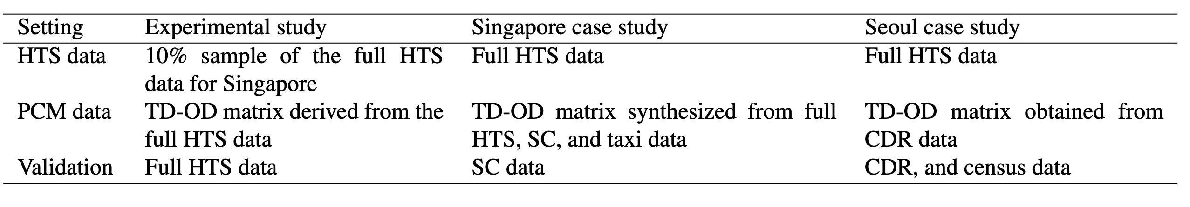
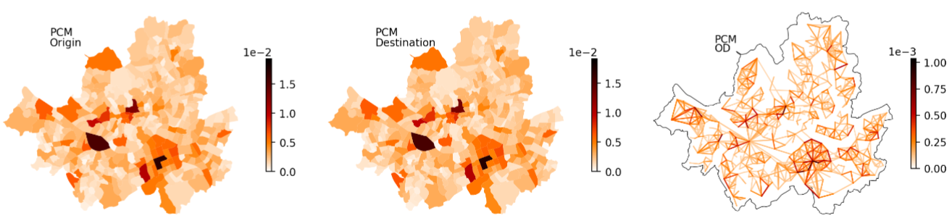
Validation Results
We used three studies to validate the proposed method
Singapore
PCM data
Seoul
PCM data

Slide 41
Validation Results
We used three studies to validate the proposed method
Information used for validation (i.e., the one not included in data fusion process)
The SC dataset (for Singapore) includes TD-OD demand for transit users categorized by age group, which are excluded during the data fusion process.
The CDR dataset (for Seoul) includes TD-OD demand for all users categorized by age group, gender, aggregated trip purpose (home, work and other), which are excluded during the data fusion process.

Slide 42
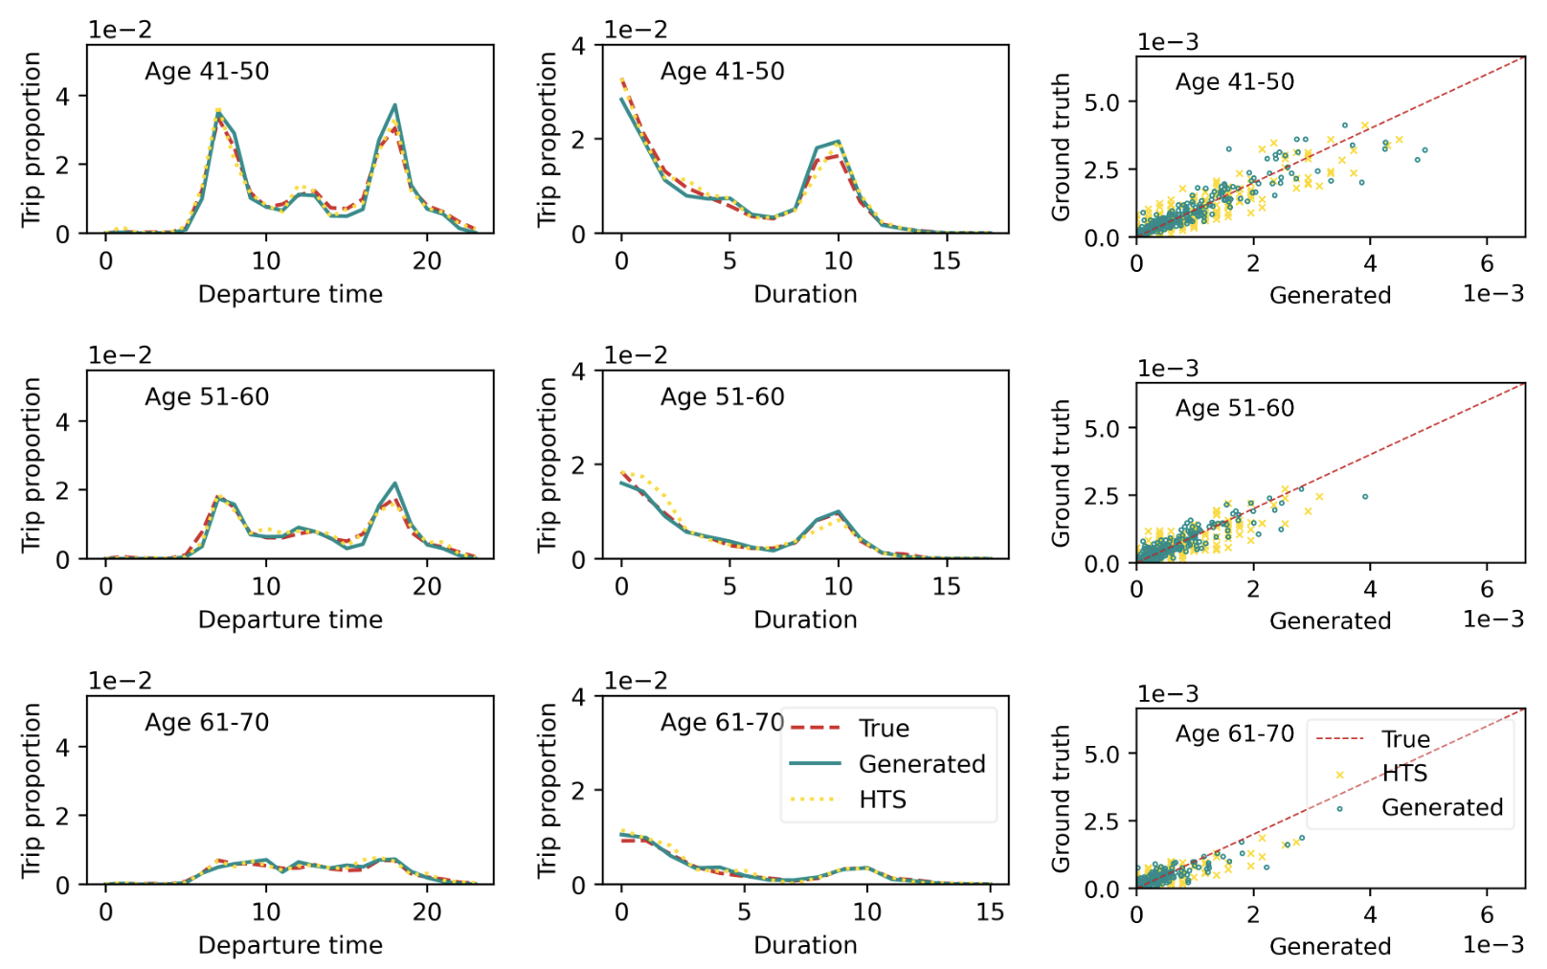
Experimental Study: Validation
Fits of joint distributions of age and other attributes to hypothetical ground truth

Slide 43
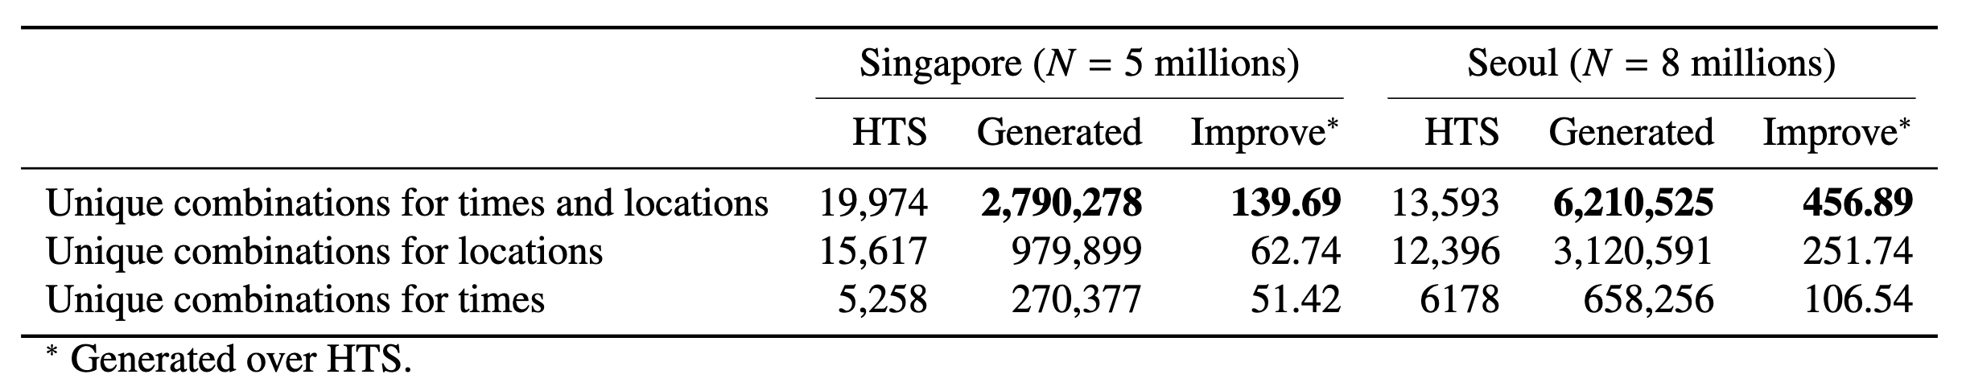
Case Studies: Increase in Spatiotemporal Heterogeneity
Spatiotemporal heterogeneity of the generated activity schedules

Slide 44
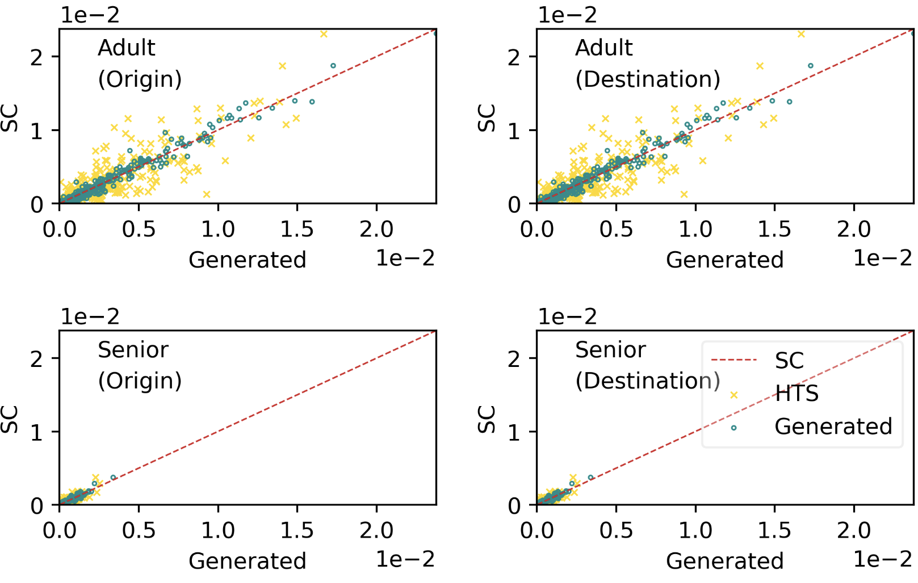
Singapore Case Study: Validation
Fits of joint distributions of age group and other attributes to smart card data

Slide 45
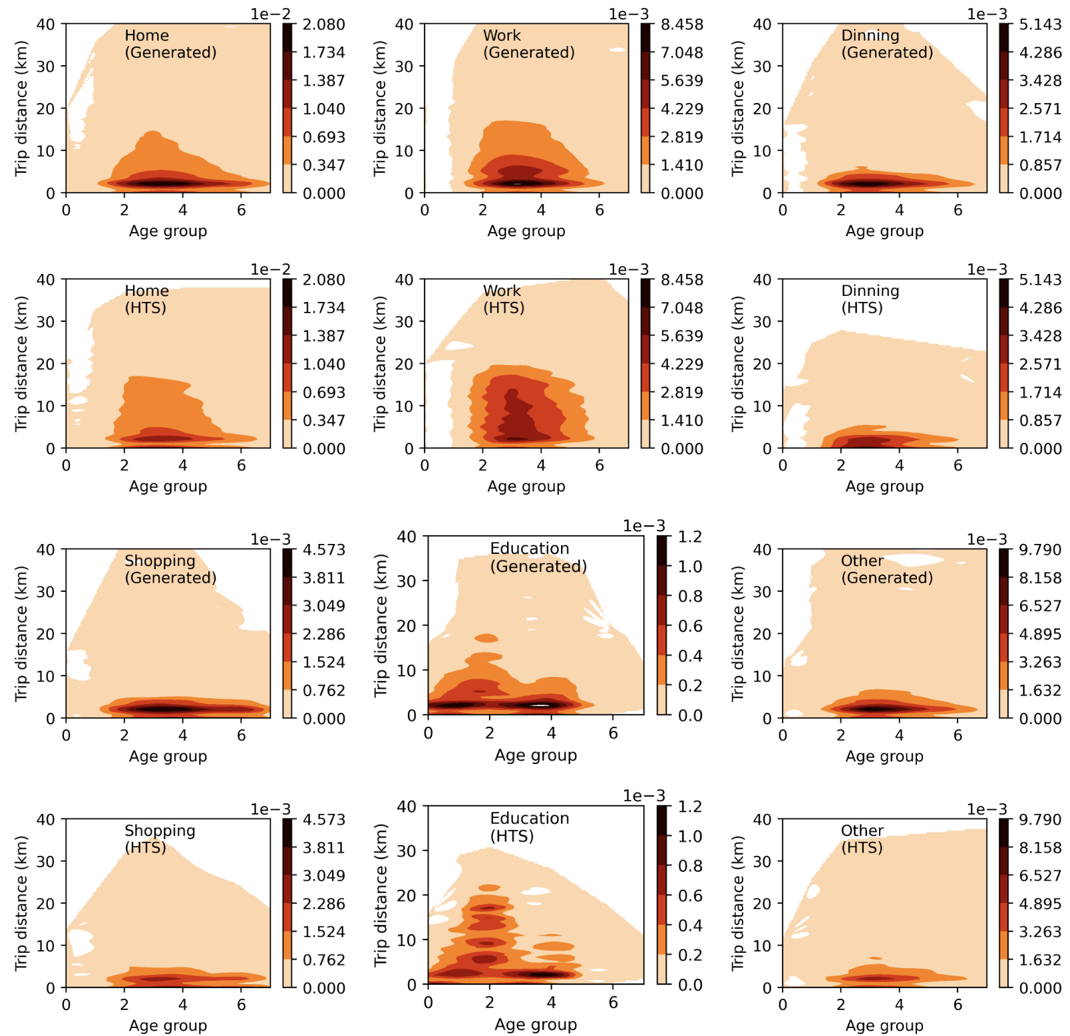
Singapore Case Study: Insights on Trip Distance Distribution
HTS overestimates trip distances (recall issue!)

Slide 46

Singapore Case Study: Insights on Trip Purpose Distribution
HTS overestimates working population.

Slide 47

Seoul Case Study: Validation

Slide 48

Seoul Case Study: Validation

Slide 49
Conclusions
Multiple data sources:
PCM data offers rich mobility insights but lacks sociodemographic and trip details.
HTS data provides crucial complementary information.
Innovative Two-stage data fusion:
Stage 1: Cluster-based data fusion approach integrates TD-OD matrix with HTS data.
Stage 2: Modified Markov models generate detailed activity schedules.
Validation:
Validating models with multiple real-world case studies (Singapore and Seoul).
Key benefits:
Enhances heterogeneity of synthetic data for transport modeling.
Supports agent-based simulations for policy and urban planning.
Balances data utility and privacy for ethical AI-driven mobility analysis.

Slide 50

LinkedIn Page
(Please follow for updates)
50

